Slide 1
《算法分析与设计》
Analysis and Design of Computer Algorithms
中南大学计算机学院
School of Computer Science and Engineering
Central South University
主讲：李敏
联系方式：limin@mail.csu.edu.cn
csu.limin@gmail.com

Slide 2
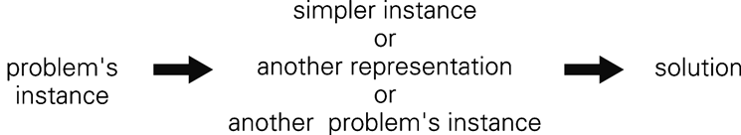
变治法(Transform and Conquer)
减治是基于变换的思想。
分两个阶段工作，即“变”阶段和“治”阶段.
变治法的三种类型：
  1)实例化简(instance simplification)
  2)改变表现(representation change)
  3)问题化简(problem reduction)
Central South University

Slide 3
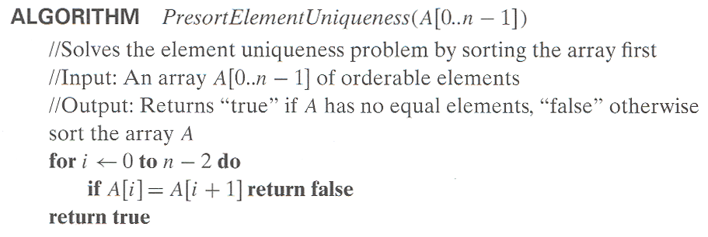
预排序(Presorting)
如果列表是有序的话，许多关于列表的问题更容易解决。
例1：检查数组中元素的唯一性
T(n)=T_{sort}(n)+T_{scan}(n)
T_{sort}(n)=Θ(nlogn)
T_{scan}(n)=Θ(n)
T(n)= Θ(nlogn)
Central South University

Slide 4
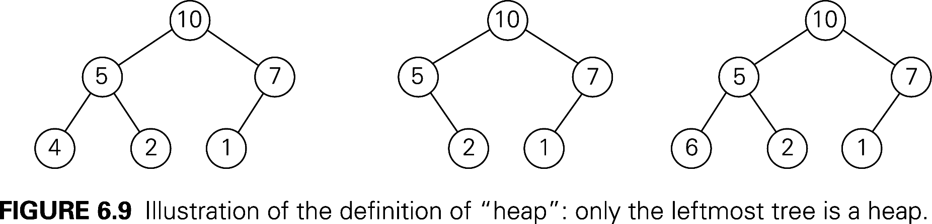
堆(Heap)
堆：一棵二叉树，且满足以下条件：
  是一棵完全二叉树
  每个节点的键大于或等于子女节点的键
All its levels are full except possibly the last level, where only some rightmost leaves may be missing.
…
Central South University

Slide 5
Properties of Heaps (1)
9
Heap and its array representation.
  think heap as a binary tree.
  it is easier and more efficient to implement a heap using an array.
    Store the BFS traversal of the heap’s elements in position 1 through n, leaving H[0] unused.
Relationships between indexes of parents and children.
5
3
1
4
2
1 2 3 4 5 6
9 5 3 1 4 2
PARENT(i) LEFT(i) RIGHT(i)
return ⎣i/2⎦
return 2i
return 2i+1
Central South University

Slide 6
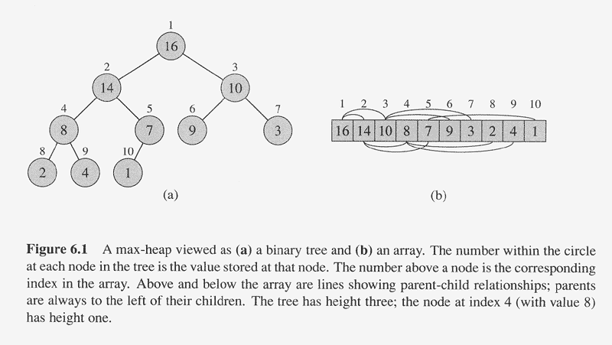
Central South University

Slide 7
Properties of Heaps (2)
Max-heap property and min-heap property
  Max-heap: for every node other than root, A[PARENT(i)] >= A(i)
  Min-heap: for every node other than root, A[PARENT(i)] <= A(i)
The root has the largest key (for a max-heap)
The subtree rooted at any node of a heap is also a heap
Given a heap with n nodes, the height of the heap,
h = log n .
Central South University

Slide 8
Bottom-up Heap construction
Build an essentially complete binary tree by inserting n
keys in the given order.
Heapify a series of trees
1. Starting with the last (rightmost) parental node A(n/2), heapify/fix the subtree rooted at it:
if the parental dominance condition does not hold for the key at this node then
    exchange its key K with the key of its larger child;
    Heapify/fix the subtree rooted at it ;
    (now in the child’s position)
2. Stops after this is done for the tree’s root (A(1)).
Central South University

Slide 9
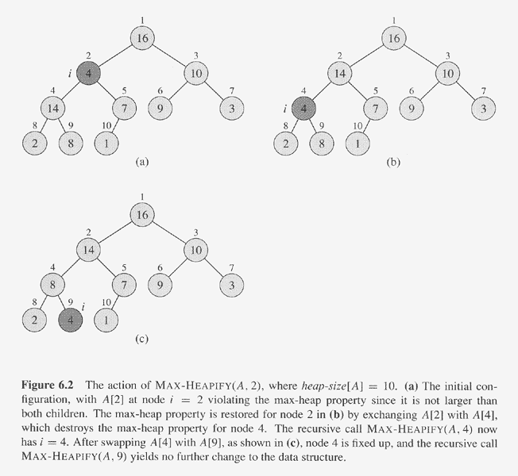
Central South University

Slide 10
BuildHeap()
  Fact: for array of length n, all elements in
  A[⎣n/2⎦ + 1 .. n] are heaps (Why?)
  So:
    Walk backwards through the array from n/2 to 1, calling HEAPIFY() on each node.
Central South University

Slide 11
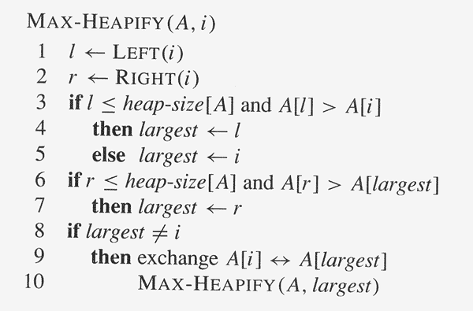
ALGORITHM HeapBottomUp(A[1..n])
for i ← ⎣n/2⎦ downto 1 do
MAX-HEAPIFY(A, i)
Central South University

Slide 12
Central South University

Slide 13
Example: 4 1 3 2 16 9 10 14 8 7
→ 16 14 10 8 7 9 3 2 4 1
在最坏的情况下，自底向上构建堆的算法的效率？
Central South University

Slide 14
Worst-Case Efficiency
Worst case:
a full tree; each key on a certain level will travel to the leaf.
  Fix a subtree rooted at height j: 2j comparisons
  Fix a subtree rooted at level i : 2(h-i) comparisons
    A node’s level + its height = h, the tree’s height.
  Total for heap construction phase:
h-1
Σ
2(h-i) 2^{i} = 2 ( n – lg (n + 1)) = Θ(n)
i=0
# nodes at level i
Central South University

Slide 15
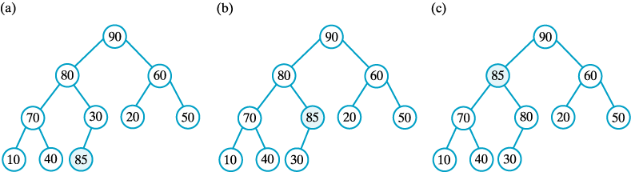
如何自顶向下构建堆？
通过把新的键连续插入预先构造好的堆，来构造一个新堆。
Central South University

Slide 16
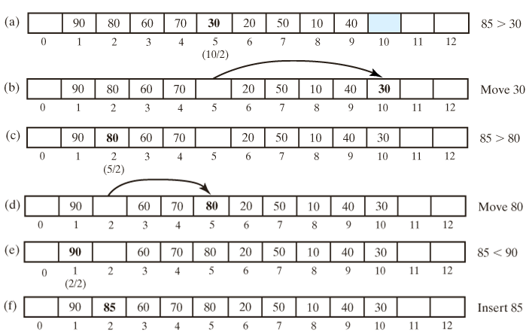
Adding an Entry

Slide 17
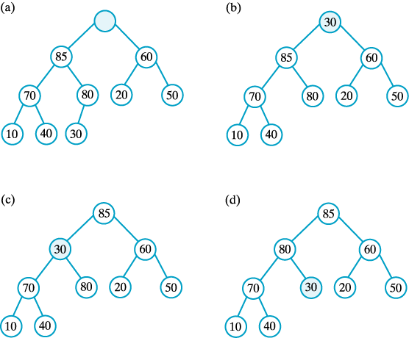
删除元素
堆调整与数组变化的
关系:
加入元素时向上调整
删除元素时向下调整

Slide 18
堆排序
若在输出堆顶的最小值（最大值）后，使得剩余n-1个元素的序列重又建成一个堆，则得到n个元素的次小值（次大值）……如此反复，便能得到一个有序序列，这个过程称之为堆排序。
1、构造堆（为一个给定的数组构造一个堆）
2、删除最大键（对剩下的堆应用n-1次根删除操作）

Slide 19
13
输出根并以最后一个元素代替之；
比较其左右孩子值的大小，并与其中较小者交换；
97
27
27
97
38
49
49
49
76
65
97
97
小根堆
13

Slide 20
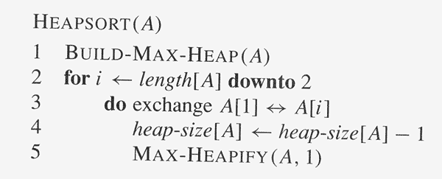
Heap sort
Central South University

Slide 21
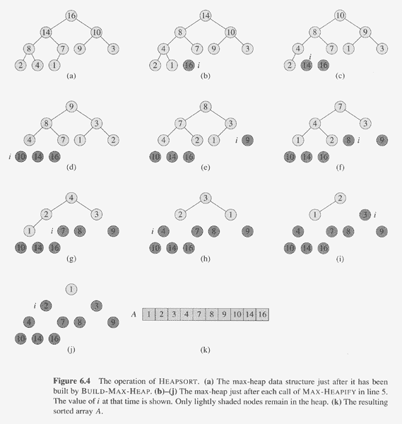
Central South University

Slide 22
Analysis of Heapsort
Recall algorithm:
    Bottom-up heap construction
    Root deletion
    3. Repeat 2 until heap contains just one node.
Θ(n)
Θ(log n)
n – 1 times
Total: Θ(n) + Θ( n log n) = Θ(n log n)
Note: this is the worst case. Average case also Θ(n log n).
Central South University

